Slide 1

Hybrid Assets – Design Challenge
Jim W.

Slide 2
Customer Data – On Premise
MoneyMaker’s Bank has customer data on premise and is currently on UCCX.
They use the UCCX Script with the “Database Read” step to integrate with their On-Premise Database.
The Microsoft MS SQL 2015 database stores:
Account Information
Customer Details
CCX Call Flow Script Connects to it using a raw JDBC connection string. jdbc://___
The Agents also have access to a Web site on-premise integrated with Cisco Finesse to Screen Pop
the Customer Account Information that Agents use on-premise internally via VPN.

Slide 3
Customer Data – On Premise
They:
Want to move to Webex Contact Center
Want access to their data in the Self-Service (IVR) Flows
Want Agents to have access to their on-prem website inside the Desktop

Slide 4
Customer Data – On Premise
How do we access on-premise databases?

Slide 5
Customer Data – On Premise
How do we access on-premise databases?
Internet REST API access
No internet Rest API but Customer has an internal Web service for lookups
No Rest API and no Web Service = Customer only has raw JDBC access!

Slide 6
Let’s Look at the Solution..

Slide 7
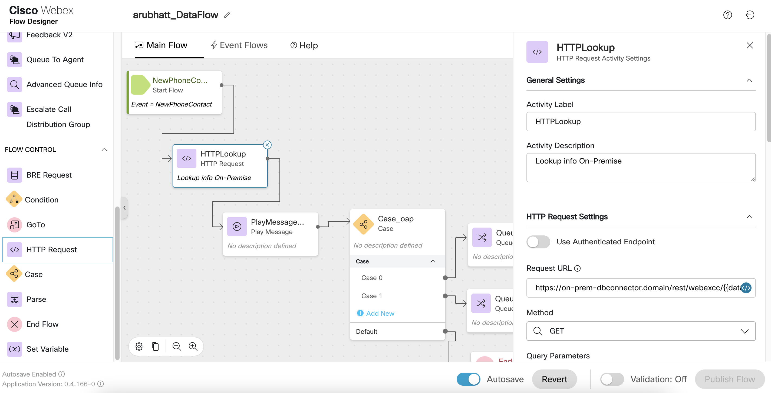



What is the WebexCC DB Connector Project?
https://github.com/CiscoDevNet/webex-contact-center-dbconnector
Authenticated
HTTPS
DBConnector Service
JDBC
MySQL /
Oracle /
MS SQL Server
Internet
DMZ
On-Prem
Connect on-premises databases via JDBC >> REST interfaces
Opensource and extensible!

Slide 8
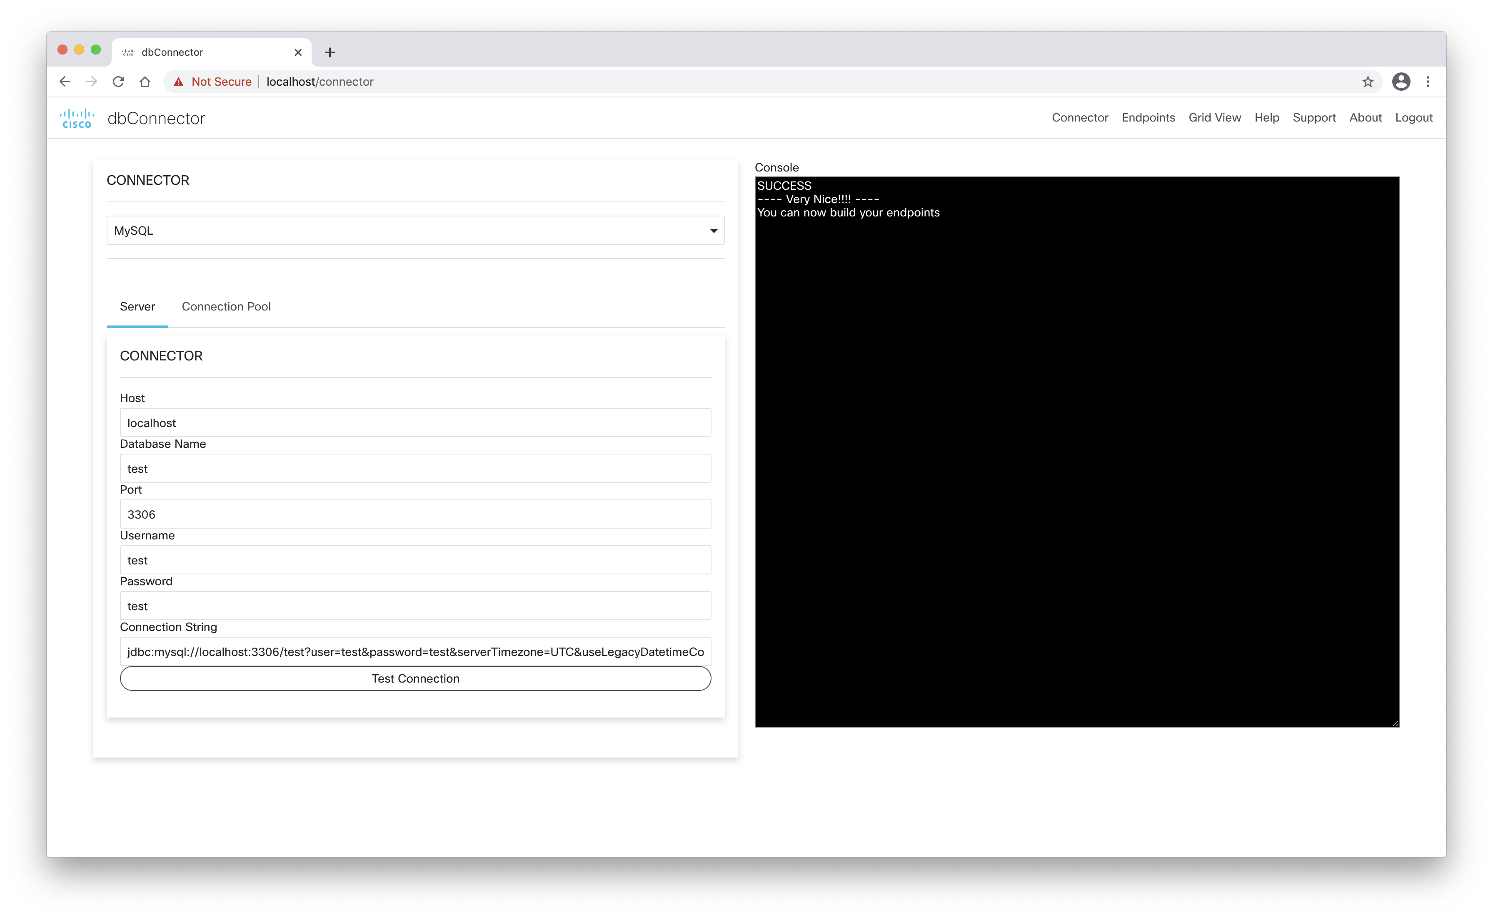
WebexCC DB Connector: Open Source Sample
Run as a Java App
Run on VM or run as a Container
Connect to your On-Prem datasource using jdbc://
Test Connectivity
See live results of sample queries
Test Connectivity of your JDBC Compatible Datasource

Slide 9
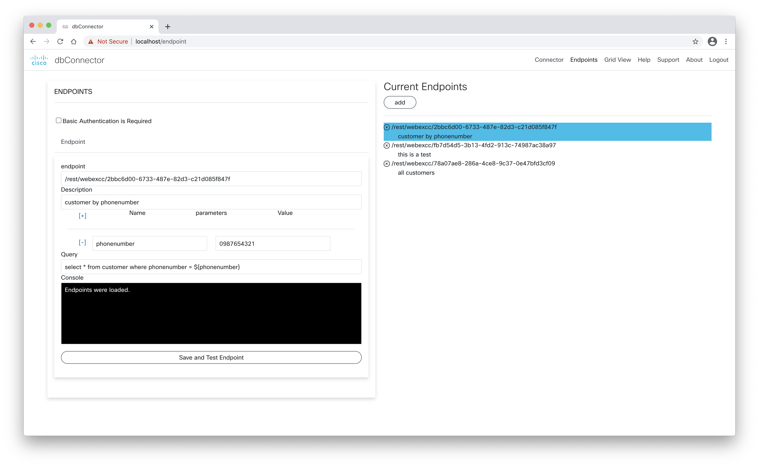
WebexCC DB Connector: Open Source Sample

Slide 10
WebexCC DBConnector
Configuring the HTTP Lookup on Flow Designer

Slide 11
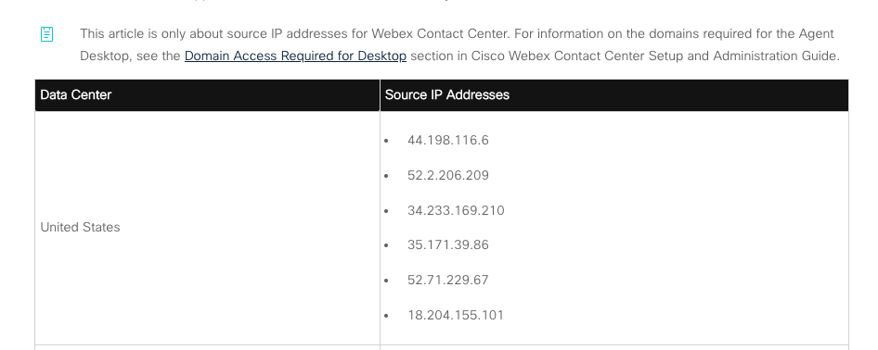
Security Settings & Best Practices
Explicit Allow—listing of WebexCC Source IP Addresses
Security Settings for Webex Contact Center: Search help.webex.com
Allow IPs on the firewall as SRC (Source)

